Slide 1

GUI for Materials Science
Gamma Steel
Group members
Karla Antonieta Durán Oscuez
Bryan Plaza

Slide 2

Problem
Design and production of scientifically proven materials
Tests and calculations using computational models
High learning curve
Installing third-party software and dependencies

Slide 3
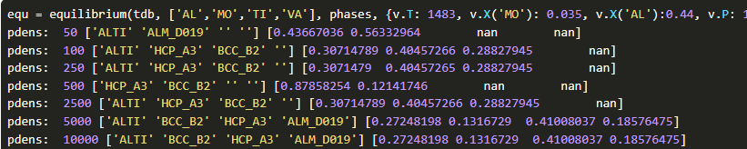
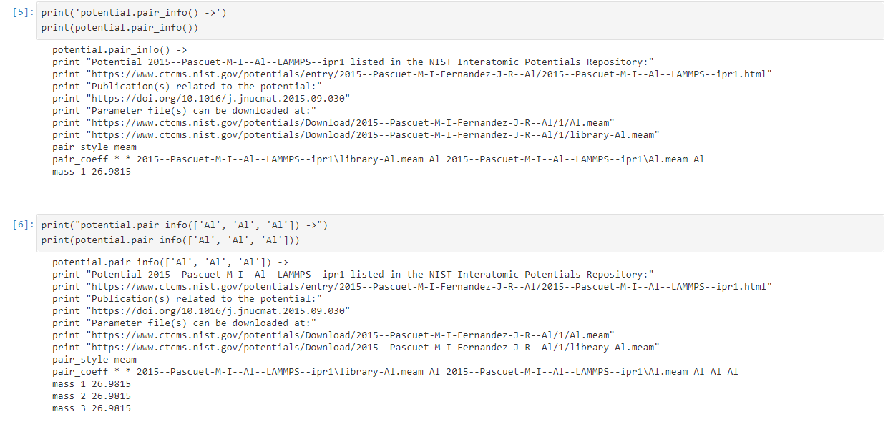
Actual context
Complex command interfaces
Massive work queues for simple model execution

Slide 4
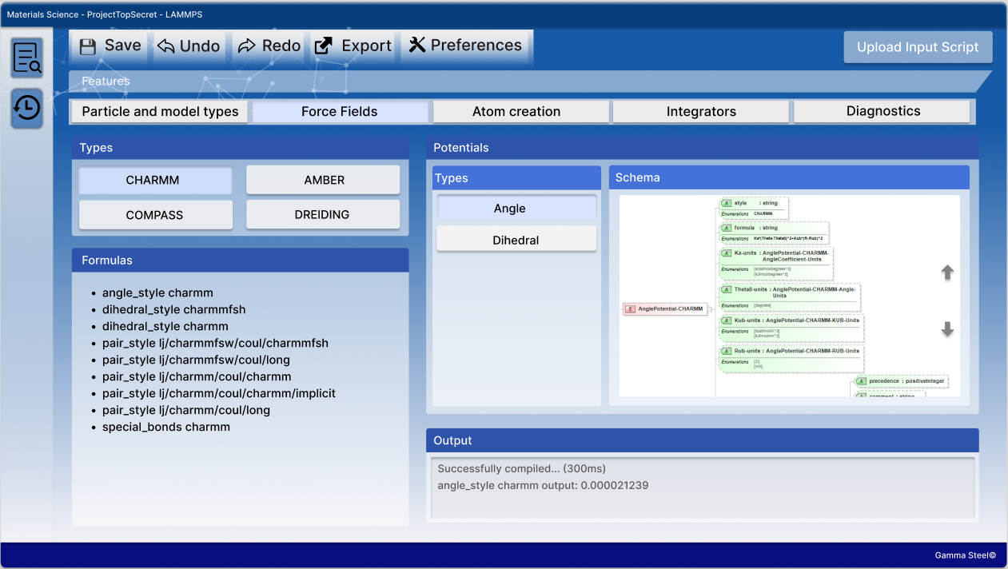
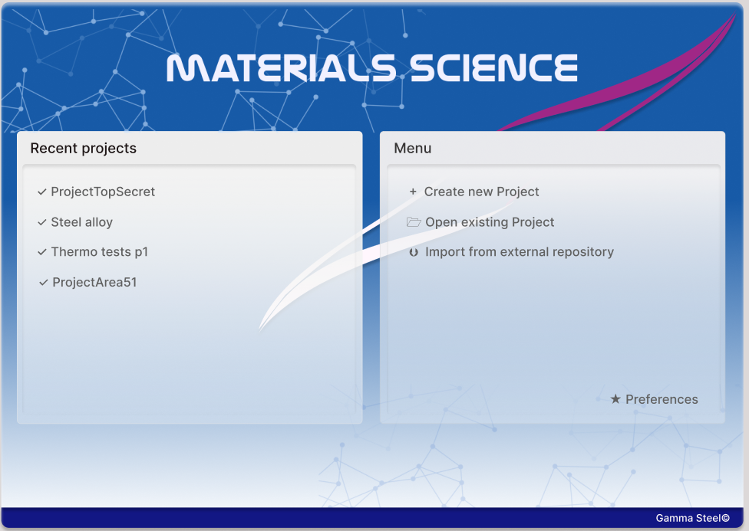
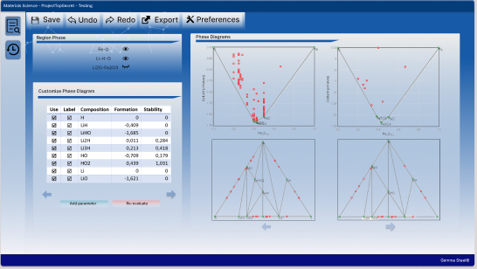
Graphical User Interface

Slide 5
Advantages and Scalabitity
Integration of functionalities by phases.
Access to large amounts of data.
Interactive and simple design.
No external facilities.
Open Source design tool.
Modulation for integration of future tools.

